Slide 2
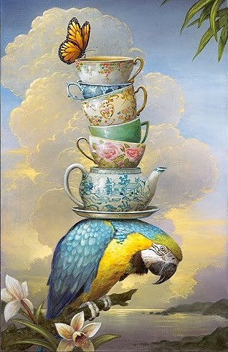
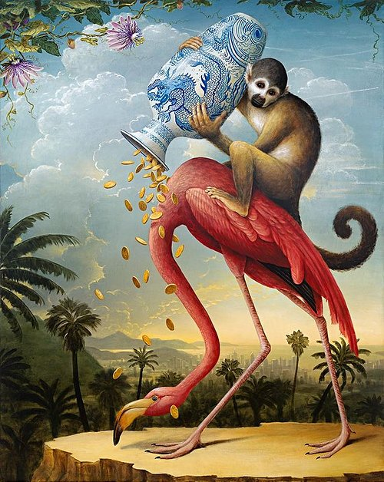
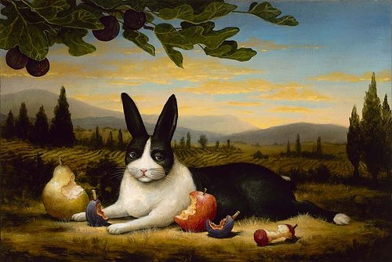
The Burden of Formality
The Donation
The Satisfied Hare
Note for self: allegorical painting
See paintings by Kevin Sloan
https://www.artistrunwebsite.com/blog/896/%22Allegorical+Realism%22%3A+Paintings+by+Kevin+Sloan

Slide 3
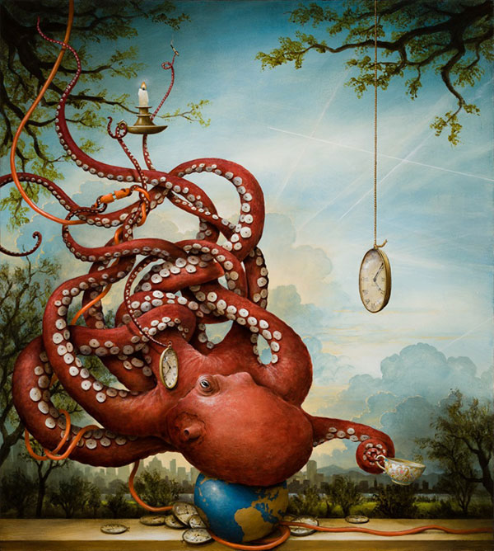
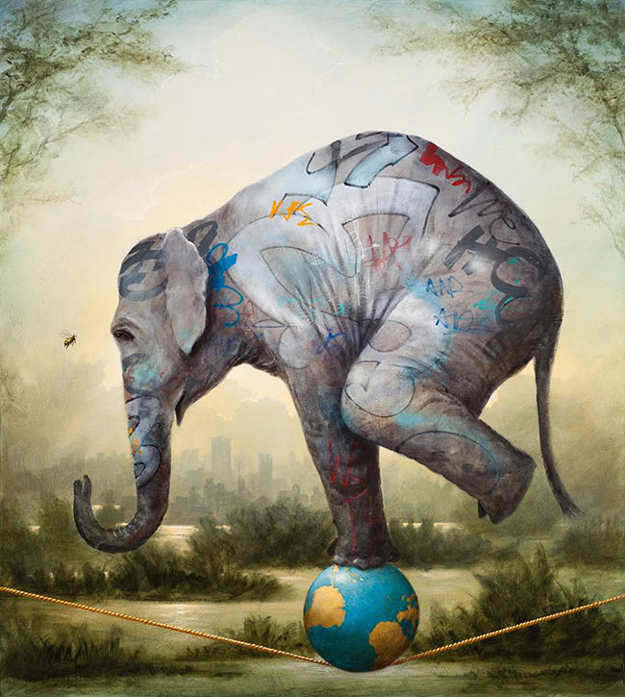

Slide 4
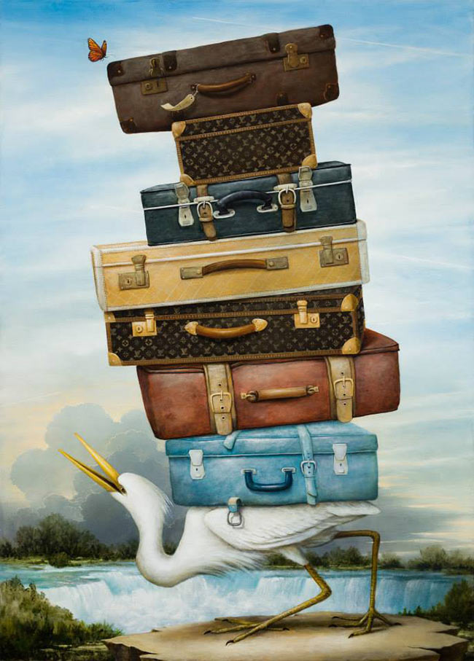
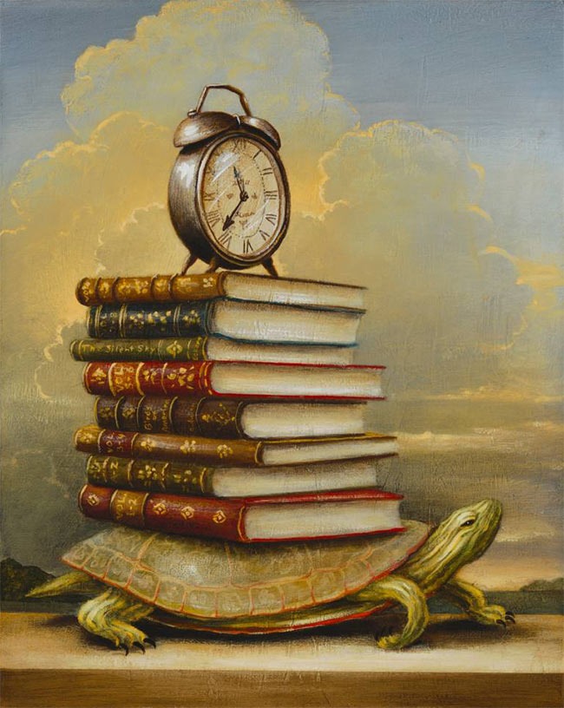

Slide 5
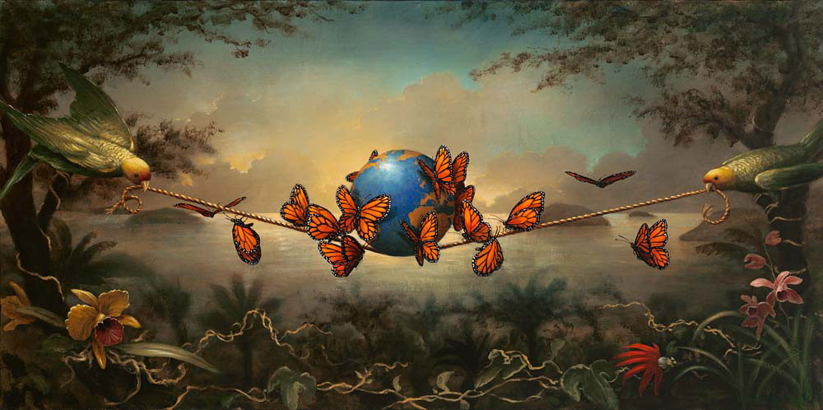

Slide 6
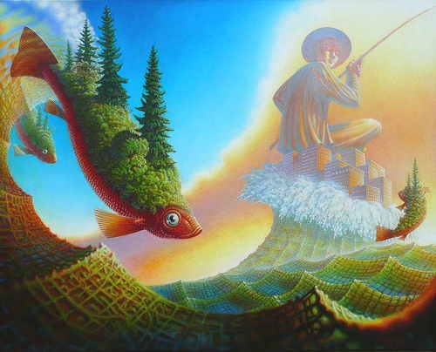
Jeff Mihalyo
The Fisherman.

Slide 7
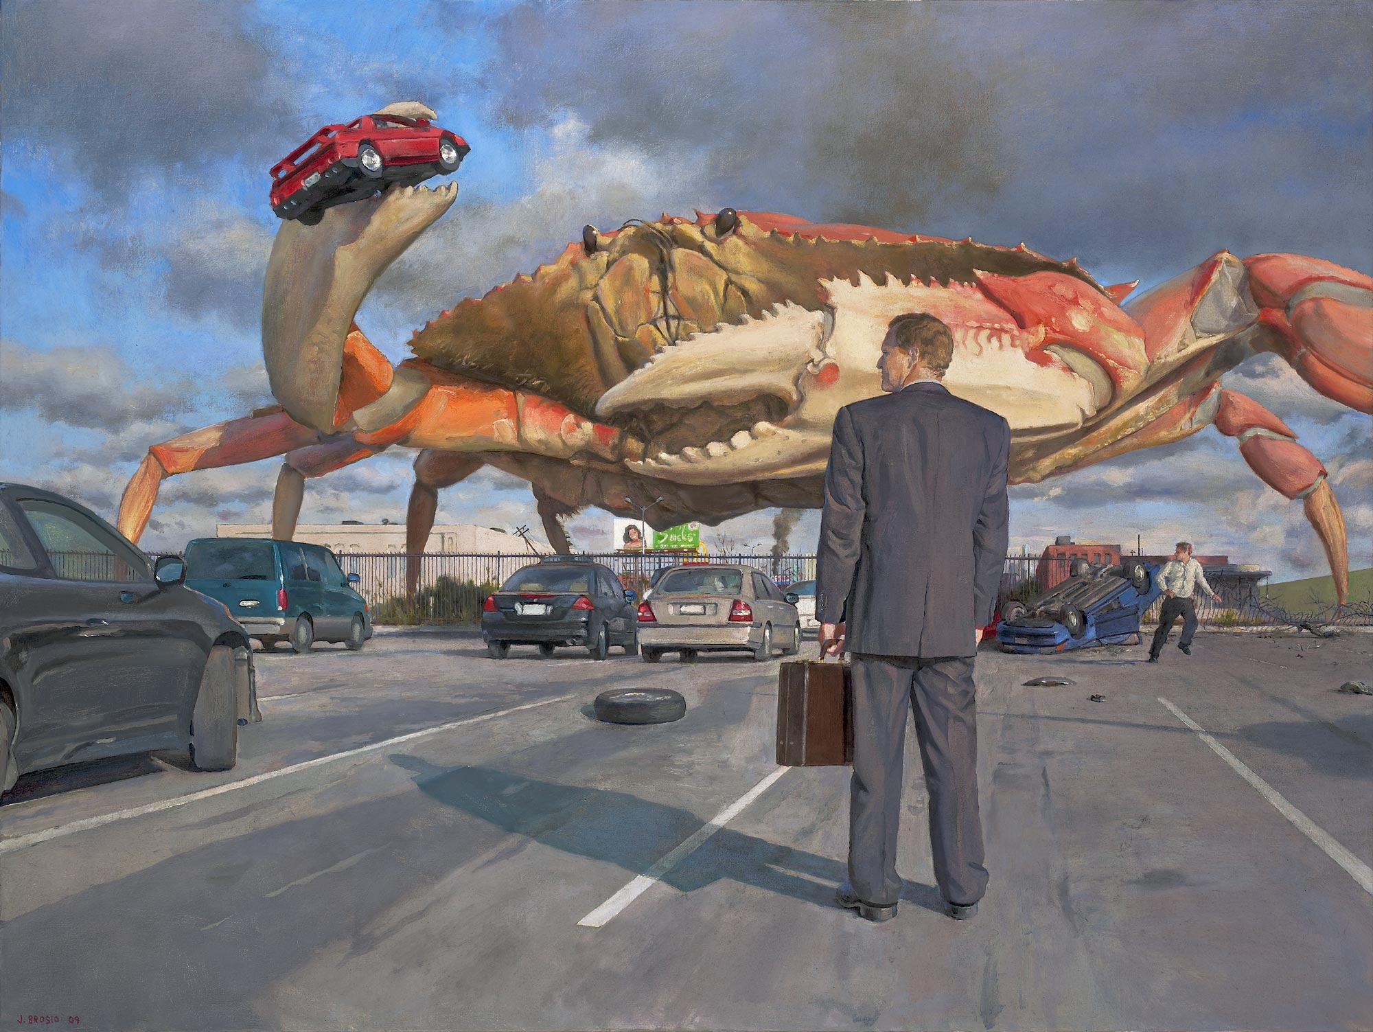
John Brosio
Fatigue 2

Slide 8
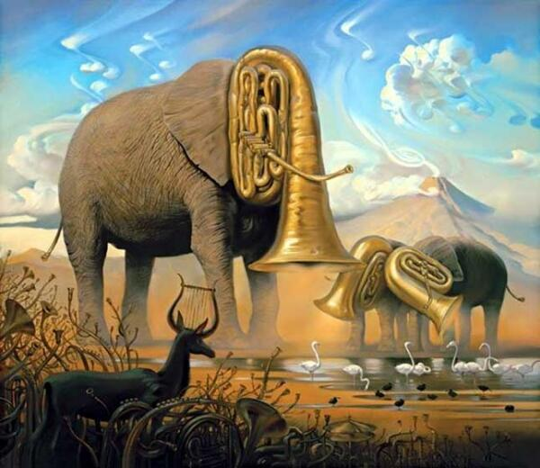
SALVADOR DALI
Eléphant de triomphe

